Slide 1

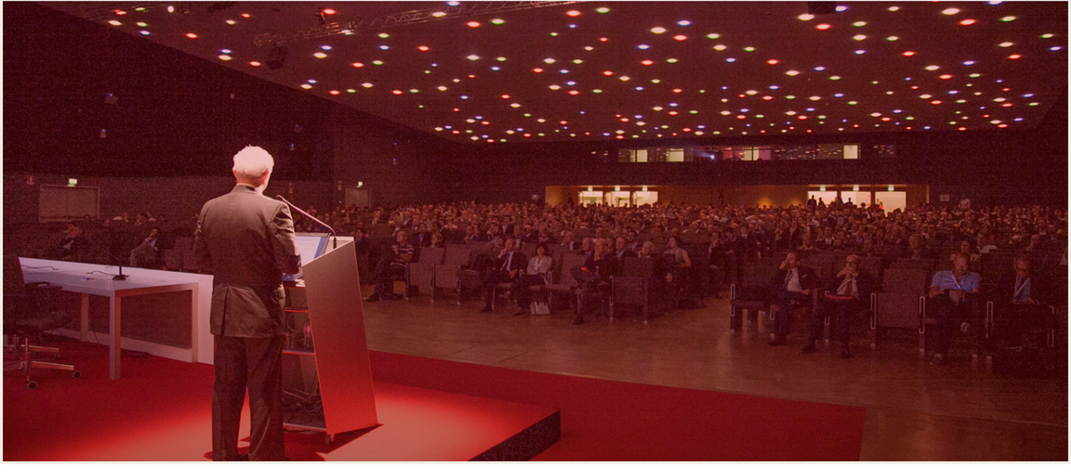
Presidential Final report 2018 - 2020
Mehmet Demirhan

Slide 2
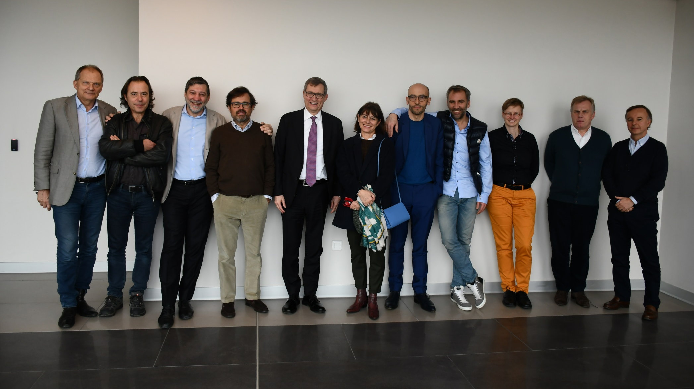
1) ExCom 2019 – 2020
Istanbul, February 9, 2019
Notes:
This is a very lovely picture of our current Executive Committee from our Istanbul Meeting. I think only Markus and Roger Van Riet are missing.
On february 9 of the last winter, we hosted an exclusive ExCom meeting in Istanbul that lasted 9 hours. This was the day when many of the innovations and improvements that will be mentioned here in a while, are discussed and accepted. I would like to start by presenting my gratitude to those wonderfull people, without them I wouldn’t find a single word to say to you!

Slide 3

PRESIDENTIAL REPORT
ExCom Meetings 2019 – 2020
New Features on the Website
Membership Committee
R&D: Norbert Gschwend Prize
Strategic Planning
Healtcare Delivery Committee
JSES
Junior Members Committee
Education Committee
Eastern European Travelling Fellowship
SECEC Certification
COVID-19
1st Virtual SECEC Congress
Finances
Notes:
This is briefly what happened during the second half of my term. We will be comprehensively infomed by the committee reports about these projects but I also would like to mention few words about all these topics.

Slide 4
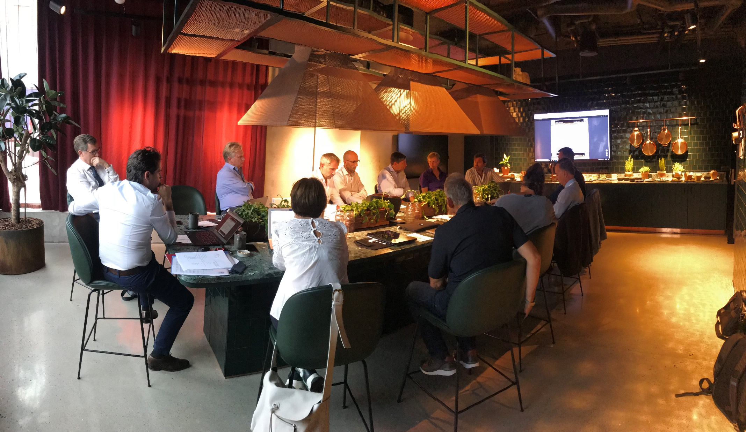
1) ExCom Meetings 2019 -2020
Notes:
Unfortunately, Copenhagen was the only occasion for seeing each other in the second half of my term.

Slide 5
1) ExCom Meetings 2019 -2020
Teleconferences
October 8, 2019
November 20, 2019 (Program Comm)
February 11, 2020 (Program Comm)
February 17, 2020
May 6, 2020
June 23, 2020
August 26, 2020
Notes:
You can see in that list how much time our Executive Committee consumed for the administration of our society. Contrary to previous years we could only meet once face to face, and many times online as a video-conference.

Slide 6
1) ExCom Meetings 2019 - 2020
Committee Meetings
January 3-14 (Committee members&Chair)
Feedback and exchange of opinions with all committees

Slide 7
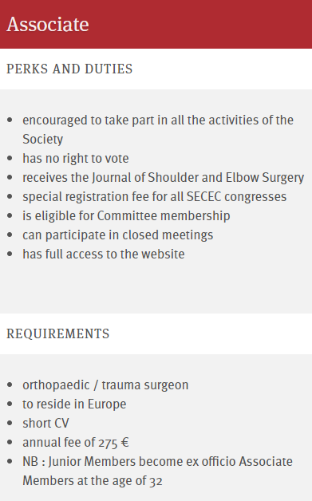
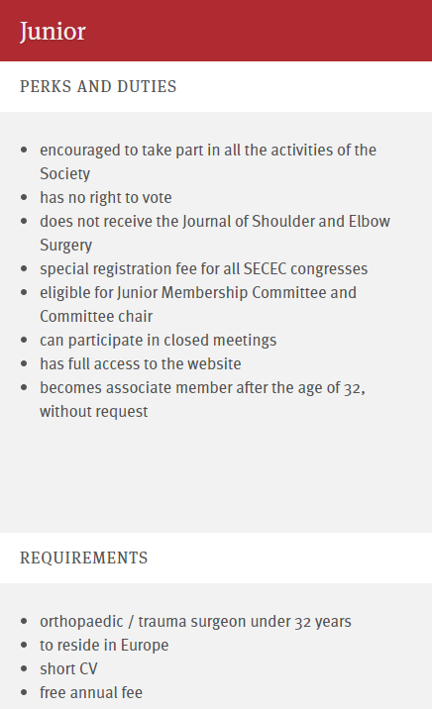
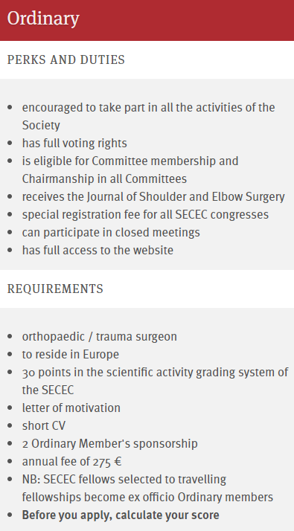
3) New Membership Criteria
Notes:
We have planned important modifications in SECEC membership criteria. Basically, being an associate and junior member became easier. However, ordinary membership which is the core of our member population remained almost the same in order to keep our scientific niveau. Here you can see the major requirements for being a SECEC member.

Slide 8
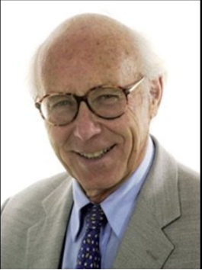
4) R&D Committee
Norbert Gschwend passed away on March 22
A new prize will be awarded after his name.
Scientific research pertaining to the elbow
Deadline: June 15, 2022

Slide 9

5) Strategic Plan 2020 – 2023
Notes:
Our strategic plan outlines many of our projects regarding our society’s future. This plan is the blueprint that you can check whether or not we fulfill our responsabilities, namely it’s the document of our accountability.
Please visit our website and read it for being able to feel like a part of the plan. SECEC is us and we all have our essential role in this plan to play when the right time comes. Please do follow and inspect our actions according to the plan. Because from now on, everything will be according to the plan!

Slide 10

5) International Committee
Newly formed committee
Scope:
Closer encountering with the international societies.
Acting faster to global issues
Harmonizing fellowships more effectively
Notes:
Recently COVID-19 pandemic has shown us that there are matters that require quick reaction on a global scale. In order to accelerate our decision making and collaboration with the international societies we intended to incorporate one of their members into SECEC’s administrative level.

Slide 11
5) International Committee
Newly formed committee!
Chair: SECEC President
Members:
1 Member ASES
1 Member from Korea
1 member from the Japanese society
1 member from the South African society
1 member from the New Zealand society
1 member from Australian Society
1 member from the South American society
1 member from Chinese Society

Slide 12
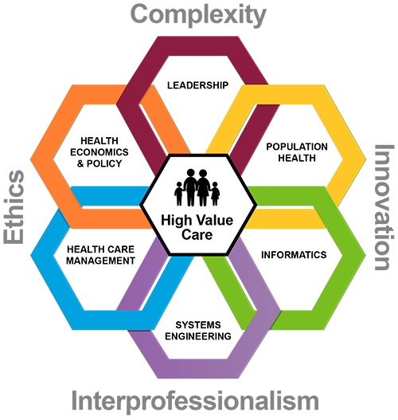
6) ‘Healtcare Delivery Committee’
Once ‘Rehab Committee’
Umbrella committee
All that is out of the OR.
Notes:
SECEC is a surgical society but even the best surgery must be consolidated. Today, in the era of multi-disciplinary medicine, incluing only physio into the friend list, is not enough.
Our Rehabilitation Committee is responsible for this completion and started in Copenhagen to expand the communication to ‘all medical professional that delivers healtcare to the patients with shoulder and elbow disorders. This is why we propose to change the committee’s name as Healtcare Delivery Committee to cover all.

Slide 13

7) Collaboration with JSES
Virtual Congress abstracts will be published on JSES-OA
A special issue
Faster publication
Notes:
As you may be aware, the abstracts accepted for the virtual congress will be published on JSES Open Access as well. This year, our abstracts will appear on a special issue, so we expect that the publication process takes much less time.

Slide 14
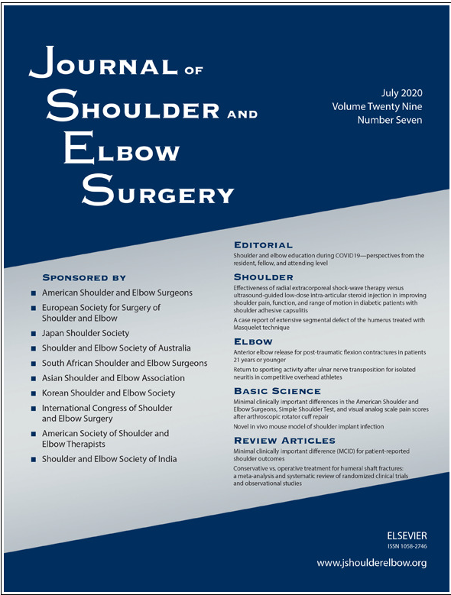

7) Collaboration with JSES
Website committe:
Establisment of the direct link between:
‘secec-essse.org’ ‘jshoulderelbow.org’

Slide 15

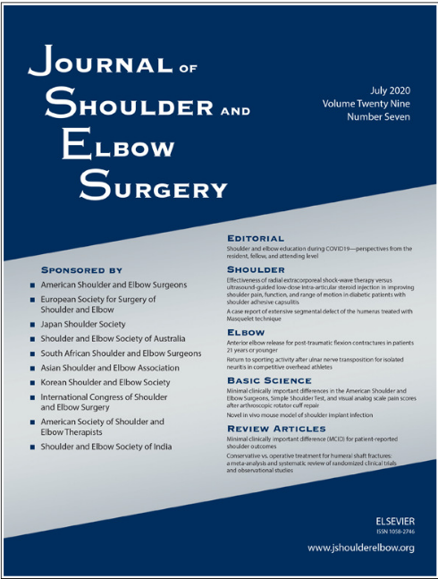


7) Collaboration with JSES
No more trees to waste for SECEC
Instead, NEW JOURNAL!
Free Access to «Seminars in Arthroplasty by JSES»

Slide 16
8) Junior Members Committee
New Committee
Collaborates with Website Committee in Social Media
Young Forum (Facebook) has 356 members!
Summer Camp 2021

Slide 17
9) Education Committee
First Webinar of SECEC, December 12, 2019
«Capsular Release of the Elbow»
Chair: Alberto Schneeberger
Roger Van Riet
Graham King
Alberto Schneeberger

Slide 18



New Fellowship Programs
Australia and New-Zealand Fellowship
Fellows chosen by their society come to visit 4 centers
Fellows are invited to the SECEC congress and gala dinner and have free registration and accommodation during congress
Notes:
We are intending to expand that list and install new fellowship programs such as New Zealand, Australia and South Africa as well as a one-way fellowship program with China.
SECEC is also very happy to host fellows from around the world.
Every year 2 fellows from Australia and New Zealand travel in Europe to visit 4 centers.

Slide 19

New Fellowship Programs
Collaboration with Chinese Shoulder and Elbow Society
One way Fellowship
Notes:
Thanks to the great efforts of the Education Committee and especially Phillippe Collin, we built a very strong relationship with teh Chinese Shoulder and Elbow Society. Our friendship started with a one way fellowship, but in the future, I am sure it will be reciprocal

Slide 20
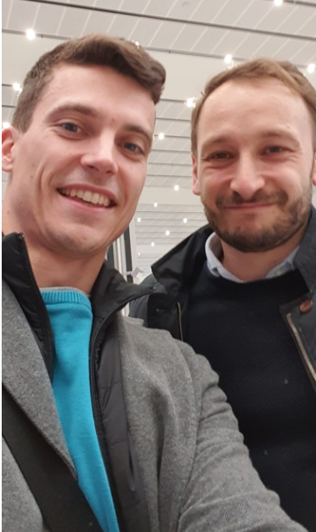
10) SECEC Eastern European Travelling Fellowship
Eastern European Travelling Fellowship
Marko Nabergoj
Karoly Schandl have travelled
Geneve, Toulouse, Poznan, Istanbul

Slide 21
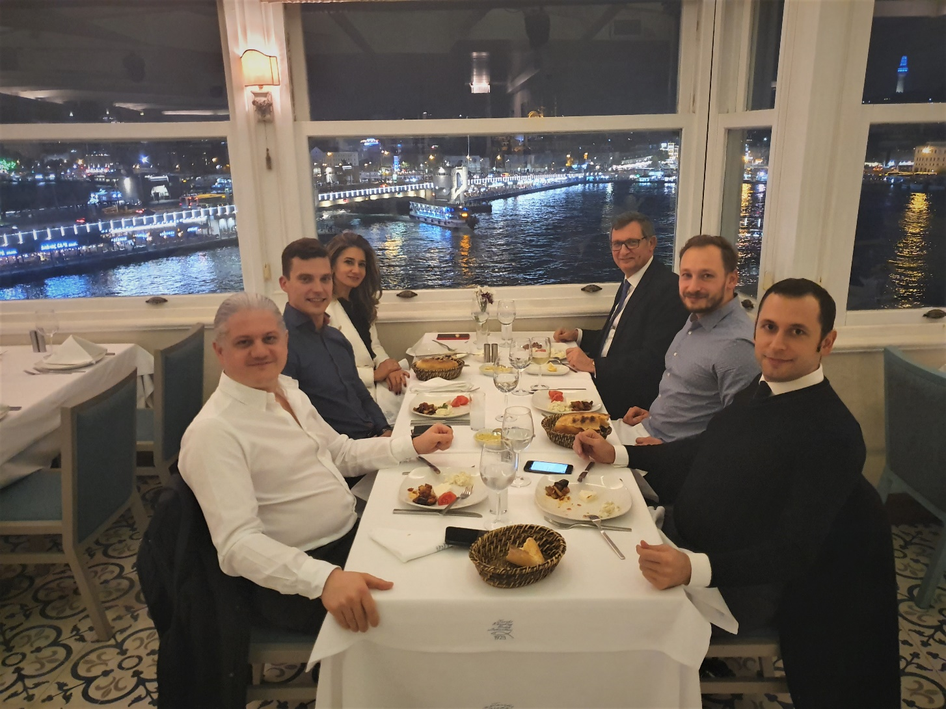
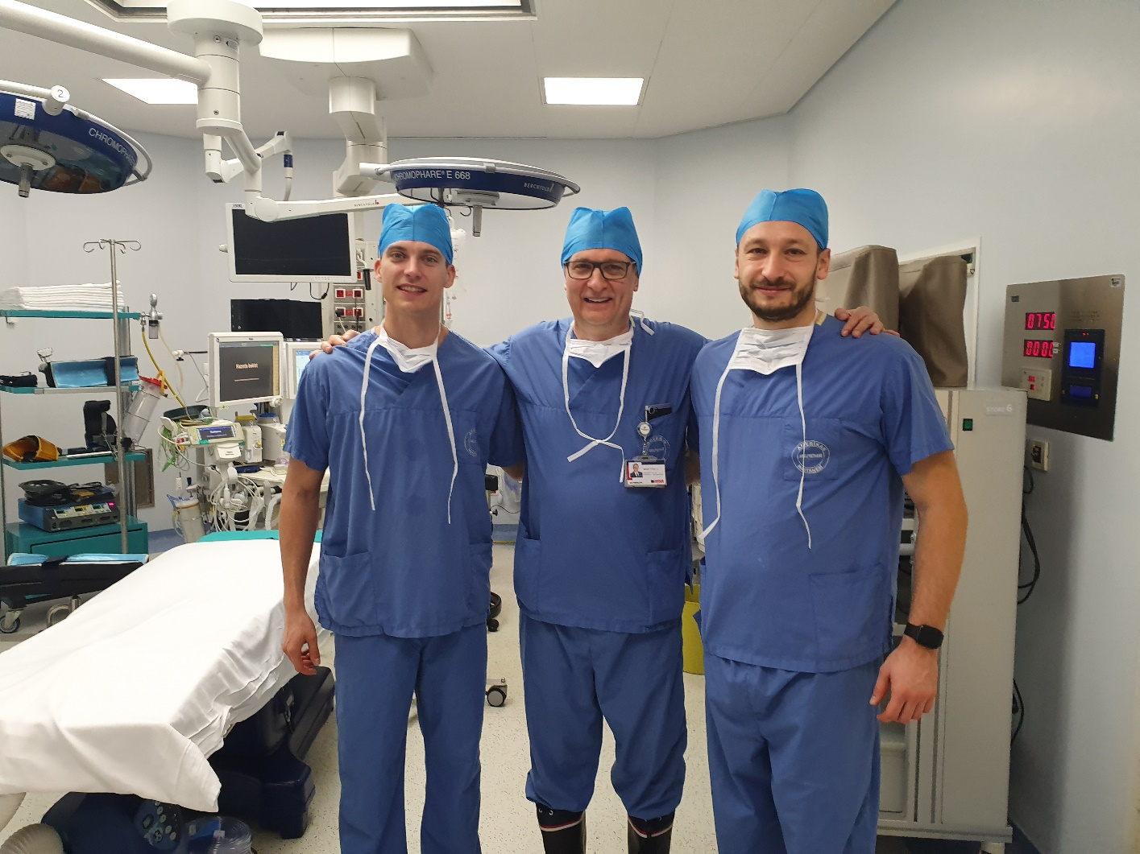
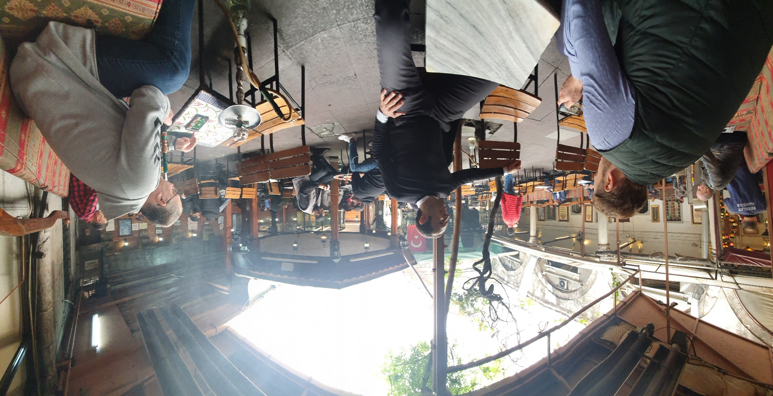
10) SECEC Eastern European Travelling Fellowship
Istanbul,
November 25, 2019 (Before Covid)
Eastern European Travelling Fellowship

Slide 22

10) SECEC Eastern European Travelling Fellowship
Eastern European Travelling Fellowship
Travel ban due to in 2020
Arthrex is the sponsor in 2021
Applications are open, 4 until now

Slide 23

11) Qualification Committee
SECEC Certificate
Recruting Teaching Centers
Applications of the candidates
SECEC Certification

Slide 24
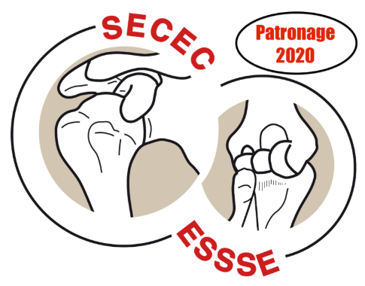
11) Qualification Committee
Qualification Credit
Given to Scientific Events
How much of the SECEC Curriculum is covered by the event’s program.

Slide 25
12) EFORT –SECEC Relations
EFORT Virtual Congress (VEC) October 28-30, 2020
SECEC concludes its rotation of Specialy Societies.
Carlos Torrens will inform us

Slide 26
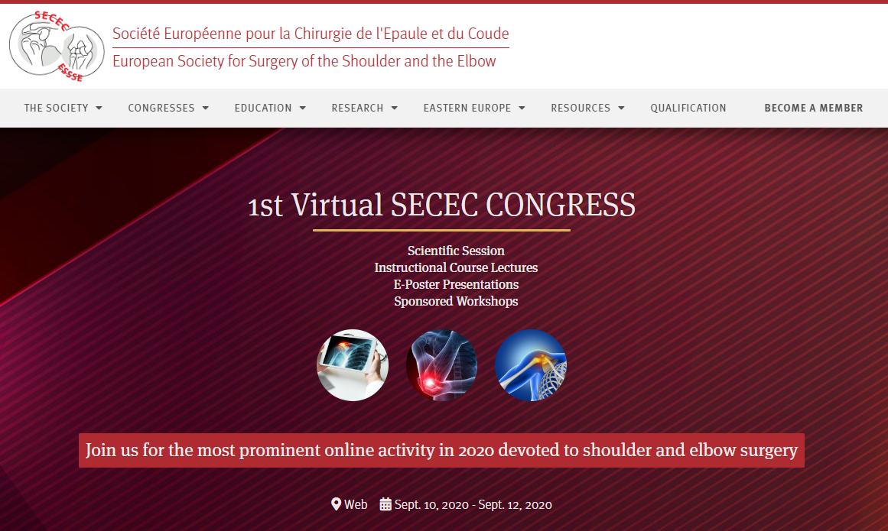
13) New Features on new Website

Slide 27
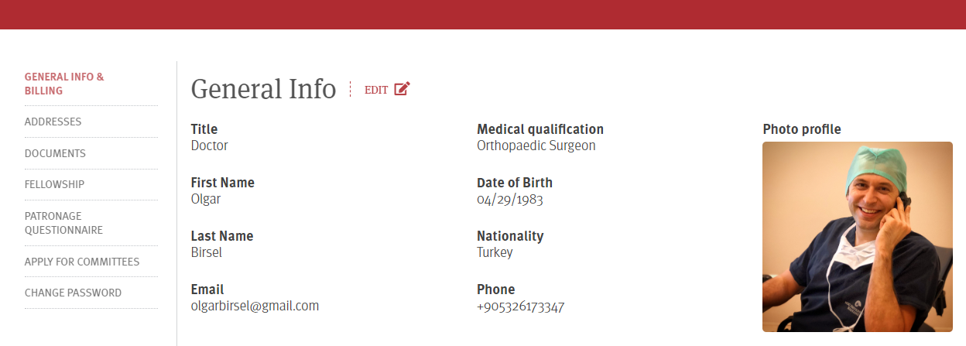
13) New Features on new Website
Members area renewed
More user friendly
Easier to communicate with the society

Slide 28
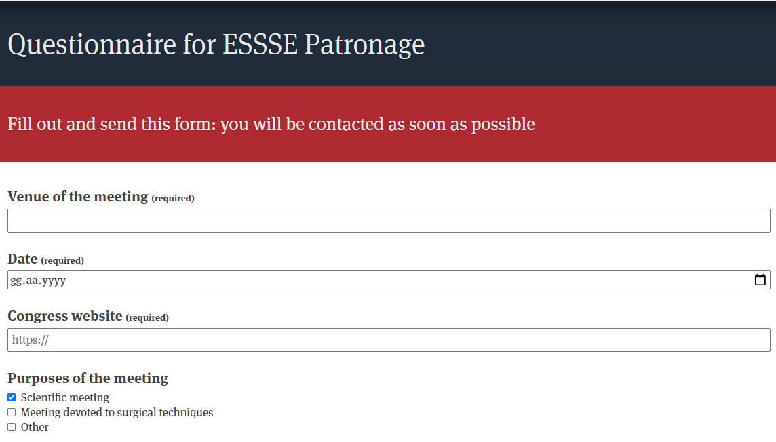
13) New Features on new Website
New patronage corner
More visibility, Easier Access, Easier application

Slide 29
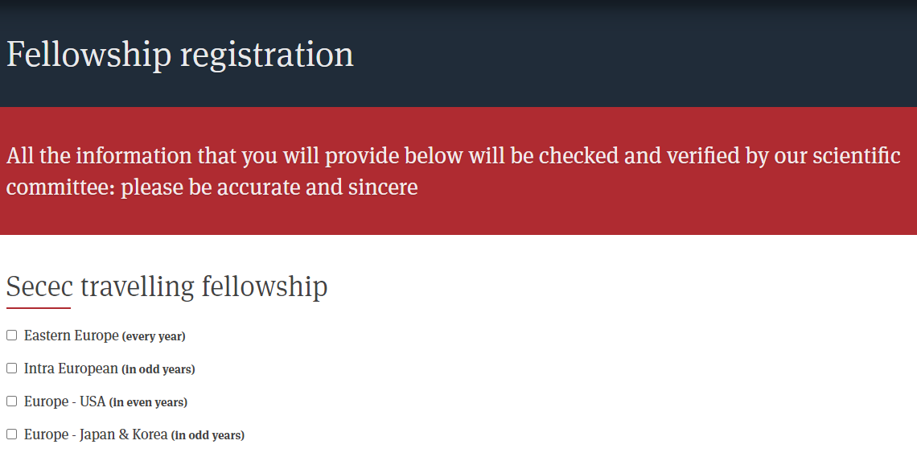
13) New Features on new Website
Easier registration for the fellowships

Slide 30


Coronavirus.
Notes:
Then you know what had happened.
This small virüs caused a huge paradigm shift that affected the entire life in our planet, drastically humans, but positively all other living creatures.
Our beloved Poznan congress was among the scientific events that have been postponed <CLICK>

Slide 31
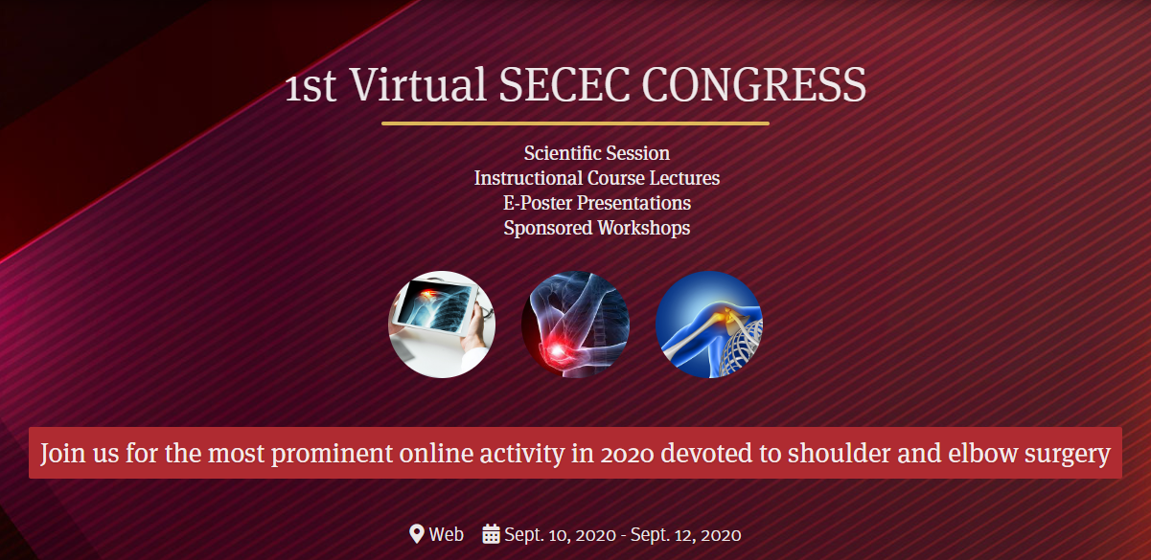
1st SECEC e-Congress
September 9, October 7, November 11, December 9,
Notes:
SECEC is a living society. It reacts very quickly for catching up with the Dynamics of the World and takes its place in the front seat.
As a preventive measure, we have postponed our face to face meeting to next year’s safe seas and quickly introduced the first Virtual SECEC Congress.
We organized many meetings to select the best content and calendar for our first e-Congress, and we hope you’ll enjoy it all along the autumn.

Slide 32
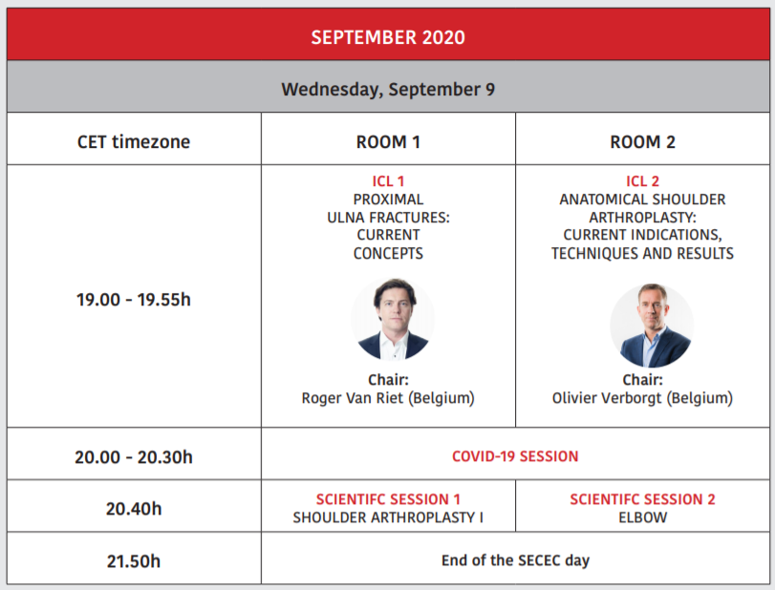
1st SECEC Virtual Congress Program
September 9
Notes:
SECEC is a living society. It reacts very quickly for catching up with the Dynamics of the World and takes its place in the front seat.
As a preventive measure, we have postponed our face to face meeting to next year’s safe seas and quickly introduced the first Virtual SECEC Congress.
We organized many meetings to select the best content and calendar for our first e-Congress, and we hope you’ll enjoy it all along the autumn.

Slide 33
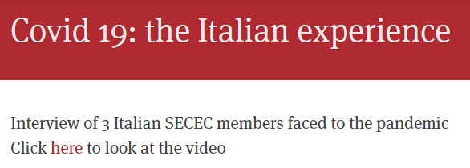
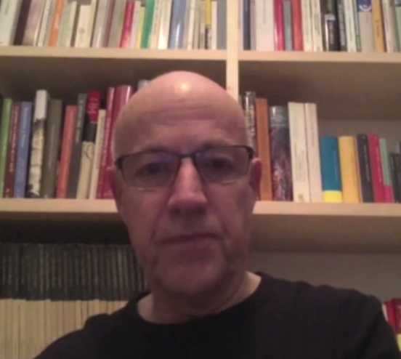
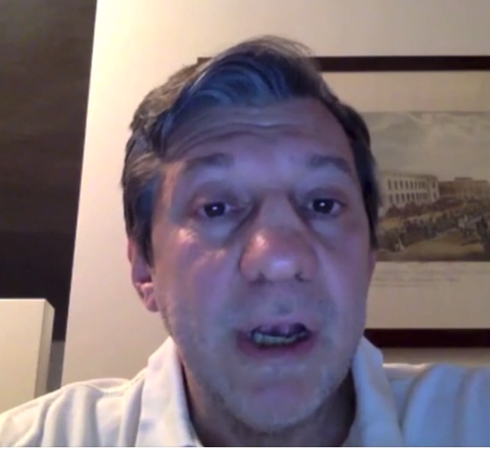
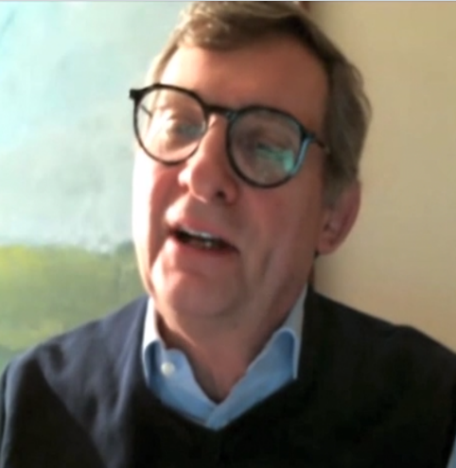
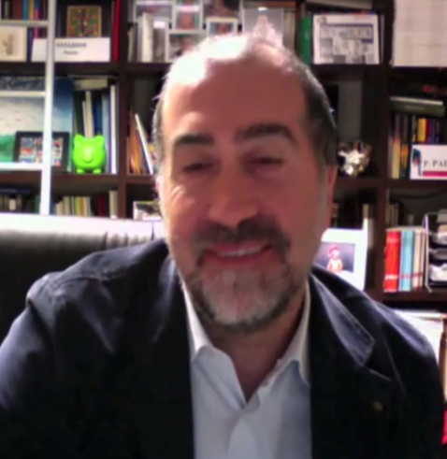
Coronavirus.
Notes:
It was not enough for us and we went further to convey the experience of our Italian members to our members all over Europe.
On April 14, in the midst of the pandemic we have organized a Zoom meeting for exchanging the experience of three Italian surgeon who are loacated in the most affected region ın Italy. This meeting was very helpful in understanding the Dynamics of the pandemic and the possible preventive attitudes.

Slide 34
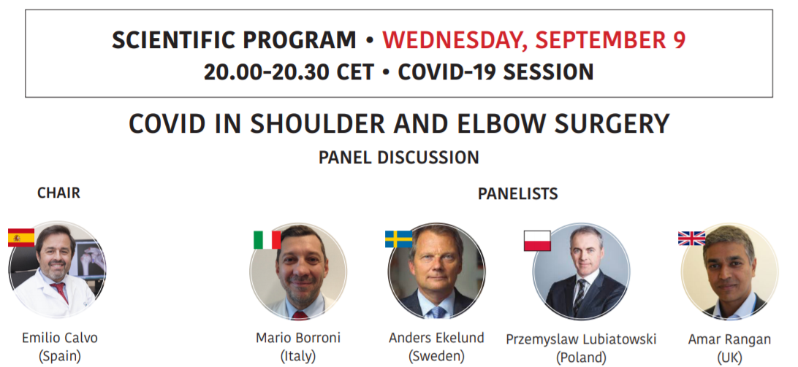
Coronavirus.
Don’t miss SECEC’s second event on the Coronavirus Pandemic reflecting the experience in ‘the eye of the strom’. It’s on September 9.
Notes:
Don’t miss SECEC’s second event on the Coronavirus Pandemic reflecting the experience from the eye of the strom. It’s on September 9.

Slide 35
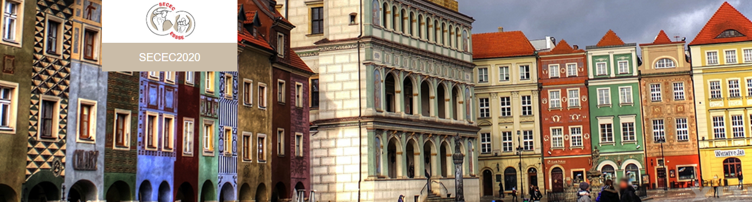
Poznań, September 8-11
Poznan will host 29th Annual Congress in 2021
SECEC is larger than the Central Europe
World renown experts will present the most recent developments

Slide 36

15th ICSES, Rome
March 17-22, 2022
Notes:
On March 17 – 22 we will meet in Rome with the shoulder and elbow surgeons from all around the World in the ınternational Congress.
As you remember, last year we decided to keep on organizing our annual congress in years when ICSES is on. The only exception was that the ICSES is held in Europe.
So, 2022 is an exceptional year and we will skip our congress and fully support the ICSES.

Slide 37



Dublin, 2023 Annual Congress
Notes:
So my Guinness here is going to get warm because the Dublin Congress is postponed to 2023, after the ICSES, Rome.

Slide 38
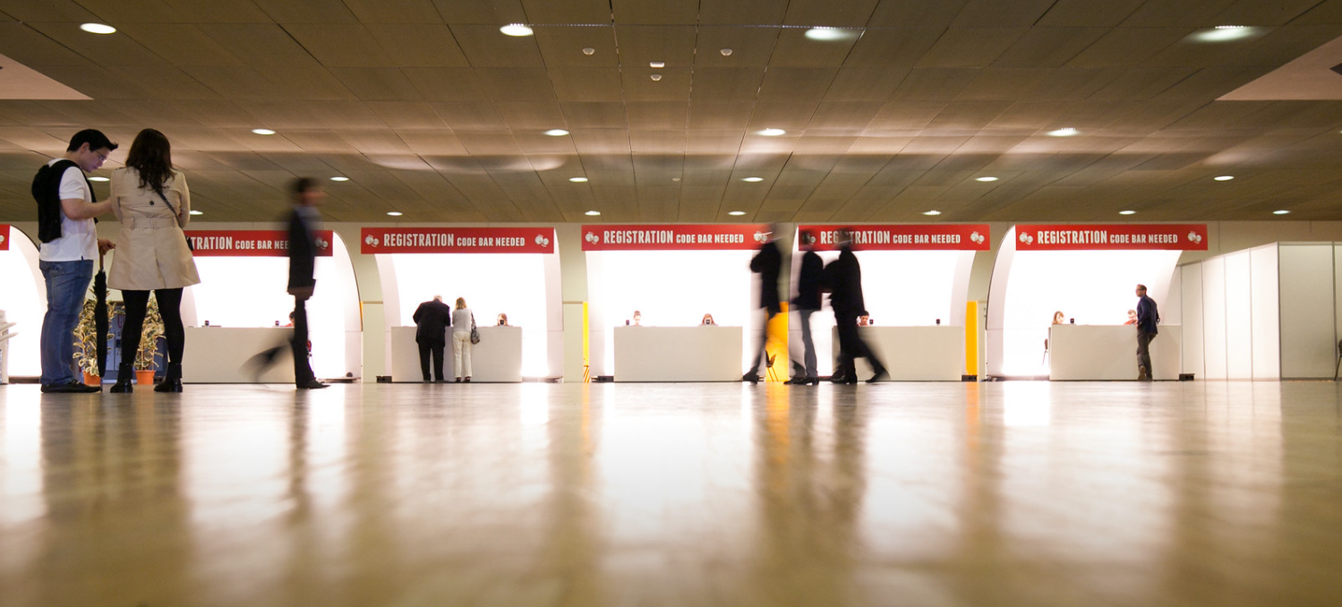
Thank You..

